Slide 1
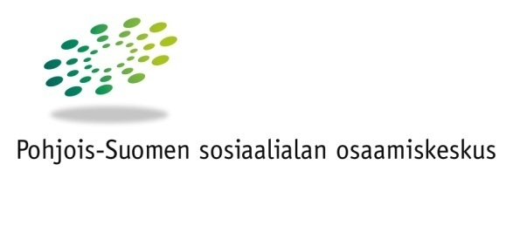
The situation in Northern Finland and prospects for future cooperation
Northern Finland Centre of Excellence on Social Welfare
Crisis and Change
Budapest, Hungary
December 10th, 2013
Jorma Kurkinen
Researcher
Oulu University of Applied Sciences, School of Health and Social Care
Northern Finland Centre of Excellence on Social Welfare POSKE
jorma.kurkinen@ulapland.fi
www.poske.fi

Slide 2

About Poske and the current change - crisis? - in (Northern) Finland
What have we done in the area of the knowledge production of well-being
Experiences of this project
Perspectives for future research cooperation?

Slide 3
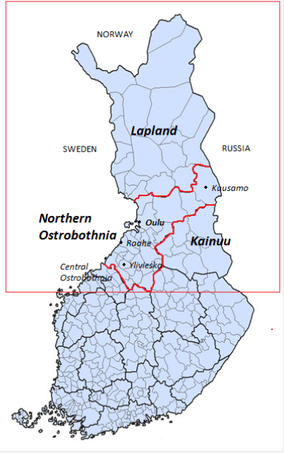

Northern Finland
© 2011 - 2013 Vidiani.com

Slide 4
Why Centres of Excellence on Social Welfare in Finland?
The responsibility for financing and providing social welfare and health care is in principle vested in strong municipalities.
  Since the end of the 1980’s a gradual change in the welfare services governing system and relations between government and municipalities.
  The gradual increase of the (statutory) duties of the municipalities.
Transition from strict governmental resource and legal control to more broad information and programme control.
To municipalities more responsibilities, but also more freedom of choice in arranging the welfare services.
At the same time the state reduced research, planning and development resources in local government organisations.
This led to increasing lack of expertise in the social field in municipalities and need to support municipalities somehow.

Slide 5
The mission of the Centres of Excellence on Social Welfare
A national network of nine Centres of Excellence on Social Welfare were established 2001 – 2002.
General purpose to provide an active cooperative structure in all provinces and covering all municipalities in Finland.
Funding by the Ministry of Social Affairs.
The operation is based on law (2002).
Mission by law:
  to secure, develop and transmit expertise in the social field
  to develop primary services and special services
  to develop the connecting structures between basic, further and supplementary training and practise
  to carry out research, experiment and development activities

Slide 6
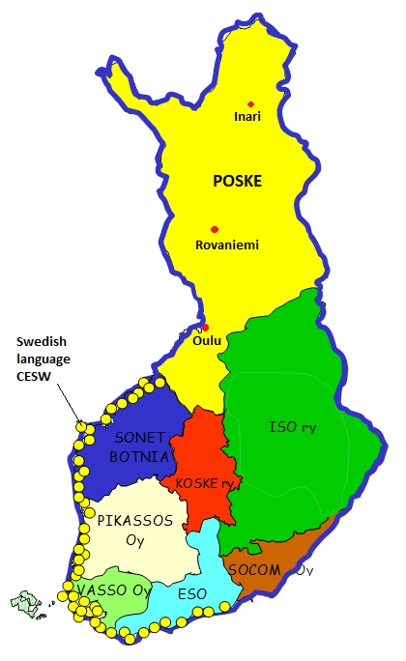
Northern Finland
Centre of Excellence on Social Welfare
One operative whole; three regional units
  Northern Ostrobothnia: Oulu
  Lapland: Rovaniemi
  Sámi District: Inari (Sami/Lapp people; indigenous people status secured by law)
Northern Ostrobothnia Unit is associated with the Oulu University of Applied Sciences, School of Health and Social Care.
Operational environment:
50 municipalities
population 580 000
longest distance 900 km
Challenges:
thinly populated area
long distances to services
growing demographic and economic polarization of the areas (concentration of population, jobs, education, services, financial resources, social capital etc.)

Slide 7
Resources
Permanent personnel in whole NFCESW eight; in addition to them several project workers
In Northern Ostrobothnia Unit:
  Social work Professor (working at the same time as professor in the University of Lapland)
  Social work Senior officer for development
  Welfare study researcher
  Researcher
  Administrative director on behalf of the Oulu University of Applied Sciences, School of Health and Social Care
Resources are limited to fulfil all the needs or areas of social field.
Have to focus and prioritize.
Central operating principle: Networking and close collaboration with all main actors and organizations: municipalities, federations of municipalities (such as hospital districts), governmental and provincial administrations, universities and other research organizations, third sector social and health care organisations and associations (NGO’s).

Slide 8
About the change and challenges in Finland
  The main challenges
  Demographic change (concentration, depopulation) and aging.
  Polarisation of areas and people.
  Social problems are culminating: unemployment (esp. youth u.) , problems of coping (families with children, mental health, drugs), risks of exclusion (esp. the young without work or training), socio-economic polarization in health.
  Increase in demand on social and health care services, growing standards of people, new ’nasty’ problems.
  Constantly rising costs in municipal finances, problems of providing the services, problems in the availability of trained employees.
  It has become difficult for small municipalities and hospital districts to manage their duties to arrange a range of social welfare and health care services locally. The inequality of service structure means inequality of people living in different areas.
  How to react, how to maintain the availability and quality of services?

Slide 9
Some trends in general discourse of social and health services
Some discussed ever since the 80’s…
  The individual responsibility and the limits of the public liability
  Relations public (state – municipalities) – private markets (outsourcing) – third sector – individuals (and families) (welfare mix).
  Effectiveness, evidence based reasoning
    New Public Management, EU membership 1995 and the European ”economic rationalism”.
  Client-oriented approach (vs. the system-oriented approach), freedom of choice in services, participation in services etc.
  How to move the focus from corrective services to preventive services and open welfare work?
  How to overcome the fragmented system of services, the lack of total liability in the client processes: service direction, holistic service plans?
  The demand for integration of the social and health services.
    How?: different operating principles and methods, different cultures, different concepts…
  The change of the concepts of ‘social’, ‘social policy’ and ‘well-being’

Slide 10
  Change or crisis?
Crisis?
  Financial, economical:
    The global crisis is ”on”; the growing debts of the municipalities and the state etc.
  Social:
    At least partly? The exclusion of the young, growing socio-economic polarization between population groups, unemployment.
  Ideological, political:
    The citizen’s support to the welfare state is crushing in Gallup polls and respective opinion surveys.
  Welfare state and services:
    Gradual change has been going on since the 80’s, boosted by the crisis of the 90’s.
    From the expansion time of the welfare state to the post-expansive era, which means reducing the public liabilities and erosion of services to some extent. Paradise Lost?
    In retrospect it has been a thorough and massive change, but it has come creeping by many separate insignificant changes, which hide the violence of the total change (the way Ulrich Beck described the coming of the second modern).
  As a whole: Definitely a change or turning point.
  The challenges are recognized and well out in political discourse.
  The politicians just don’t talk about ‘crisis’ - The new buzzword in Finland is ”the sustainability deficit”: financial, social, even human or intellectual.
  Some experts seem to be confident though that the system is adaptable enough and we have necessary preconditions for “sustainable development” in the near future (cf. Blue book with Manuel Castells etc., a future report ordered by the PM of Finland).

Slide 11
Reactions on national level
  The Service Structure Reform
  The most significant reform in the social and health field in decades (launched 2005) – a big political issue at the moment.
  Linked to a wider National Project to Restructure Municipalities and Services.
  The general purpose is to create new larger municipalities or collaborating social welfare and health care regions in order to provide public services on a broader population and financial base than at present.
    At present the solutions are still open, but the Bill should be in Parliament in spring 2014, and the Act is scheduled to enter into force in 2015.
    The project has e. g. encouraged municipalities to merge as new bigger municipalities or inter-municipal cooperation areas. (The number of municipalities has reduced dramatically in Finland 2005: 432 and 2013: 320)
    Also concerns research and development, knowledge production: How to arrange, coordinate and organize it and on what level or area. (Affects directly also to the future situation of the Centres of Excellence on Social Welfare.)
  Legislation reform: A total reform of social and health care legislation: Health Care Act was passed 2011, next phase so called Organization law, and new Social Welfare Act is being prepared.

Slide 12
Reactions on local level
  Concentration of services and cutting down of services.
  Bigger units, larger areas.
    The securing of services?
    The securing of getting trained employees?
    The accessibility and availability of services?
    The division of services and the fragmentation of services?
    The forming of service packages and client-oriented approach?
    The costs?
    The equality of people?
  The state is now degreasing the statutory obligations of the municipalities in many services – so the erosion of services will continue?
  Focus on statutory corrective services and the lack of many public open welfare and preventive services.
  The changes concern all population groups from children to the aged.
  The ‘nature’ of services changes.
  Experienced satisfaction of services?

Slide 13
The knowledge production of well-being
Back to the mission of Poske:
We soon realized that managing in the mission by the law required the development of new regional knowledge production of well-being, service needs and change.
Since 2002 we have done that in different ways:
  Produced new knowledge of experienced well-being and welfare services and their development needs.
  Developed methodologically the measurement and the indicators of experienced regional well-being and the model of analysis and interpretation of the data.
Promoted the use of knowledge in practise in development work, strategy work, decision making.
Developed the know-how and skills of central actors to anticipate and react to the change.
  A long-term goal is to build a comprehensive knowledge producing system that monitors, evaluates and predicts regional welfare on real time.
Research- based, yes, and research is not excluded.
But practical orientation in focus: research-development-practise-teaching.

Slide 14
What have we done so far
Produced knowledge of regional well-being and services (several survey researches).
Data material has accumulated.
Method has been developed (how to measure well-being, how to analyse).
We have influenced in welfare strategy work on different levels.
We have piloted an aggregated evaluation of well-being in Northern Ostrobothnia region with the Province of Northern Ostrobothnia (Council of Oulu Region ).
Have published several research publications and reports http://www.sosiaalikollega.fi/poske/julkaisut/julkaisusarja/main_page
We are known for our work and are involved in several development networks on different levels (regional and national).
Currently in progress:
Northern Finland network of knowledge producers of well-being (all the central actors involved) with the goals 1) to build The Research Programme of Northern Finland, and 2) to create a common vision of the future structure and organization of research and development and knowledge production of well-being in Northern Finland
LOSS partners and research cooperation Hungary – Finland – important opening for us!

Slide 15
Experiences of this project?
From my part this has been a very interesting project and important lesson in many ways.
We have produced new knowledge:
Change of knowledge of the situation of the partner has broadened the understanding of well-being and the processes behind it.
We have new knowledge and data material, which produces a good comparison composition for the deeper analysis in different issues.
The summary book is an significant outcome and makes the wide spreading of the knowledge possible.
Practical execution was a lesson, too:
I think, the process may perhaps not have gone exactly the way it was thought in the first meeting, but it proceeded anyway and successfully.
We met only twice face-to-face and that meant a lot of communication by e-mail, which may not be the best way, when a lot of people is involved in the process.
Keeping up the time table was sometimes a challenge. The resources in Fin side were rather thin, and that played a role, too.
Producing the articles was fun, though.
In summary
This is a good start. With this experience the readiness for good research cooperation in the future has grown – and the next step will be easier.

Slide 16
New prospects for cooperation?
We, Poske and University of Applied Sciences, are definitively open to different options and proposals.
LOSS-network and approach is a very good basis and fertile ground for cooperative research.
Widening the research network is a great opportunity.
  There is a lot of possibilities in the current (and future) materials for comparative analysis between partners: e. q. experienced well-being, satisfaction to services, informal supporting networks…
  New studies also possible? Focusing on a special theme or certain population group (the children, the aged?) or minority/ethnic groups (in Finland sámi people or romani people)? Comparative case studies on local level of service solutions?
We have actually only one ’condition’: For us the practical orientation is important and the research projects should be actively involved in joint development work. (Research-development-practise-teaching.)
As a University of Applied Sciences the link between working life and theoretical studies is very important. How we could integrate teaching and students more into research projects?
UAS have some very good experiences of this, but there is a need to widen and develop it – also in the international level.
Thank You!

