Slide 1
Relations to 1956 of NGOs and encounter movements - 1956 and the Hungarian civil society –
Péter Giczey
visiting lecturer
University of Debrecen
Mission impossible – Courage as Virtue in the Politics 7 November, 2016, Sofia

Slide 2
Methodology
Researches
Documents
Personal history
Pre-study and research questions

Slide 3
Research questions
Is civil society is an appropriate notion to use it today?
Can we talk about civil society before 1989?
What is the heritage of 1956?
Where can we find the impact of 1956 in civil society?

Slide 4
Heritage of the revolution and freedom fight of 1956
Youth and intellectual debate societies – e.g. Petőfi circle
Solidarity with Poland (Polish workers) - demonstration
Reform communists (Imre Nagy)
Independence, freedom, solidarity, democracy, multi party political system
Workers’ councils – self-governance
‘Guys of Pest’ – youth warriors

Slide 5
Civil society
„Civil society is ... a public sector, the sphere of solidarity where different interests are articulated, strain against each other, where conflicts are taking place between individuals, groups, organizations .... The relationship of these civil society, so that a reflexivity, rather than the totality of the organizations. The cross-react with each other is important, it generates a force field in which civil society is actually created.” (Ferenc Miszlivetz)
Second society (Elemér Hankiss)
Civil society was the most powerful element which caused the erosion of party states (Miklós Molnár)

Slide 6
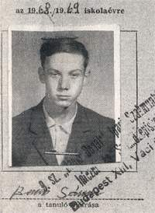
Chronolgy
1960
From 1964: Demonstrations in the garden of The National Museum (>100 persons)
20 January, 1969 – solidarity with Czechoslovakia: self-burning (Sándor Bauer, age 17)

Slide 7
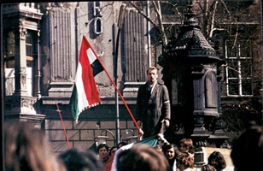
Chronolgy
1970
15 March 1972 – more than thousand youth demonstrated in museum garden, Petőfi statue and at Batthyány eternal flame
Charta ’77 (letter to Kádár
in 1979, signed 250)

Slide 8
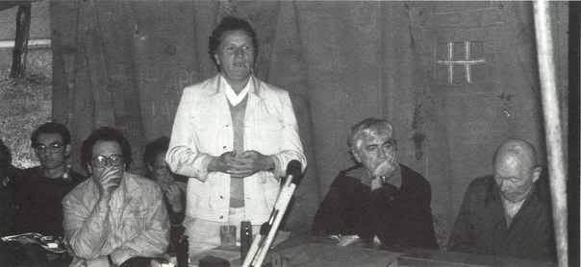
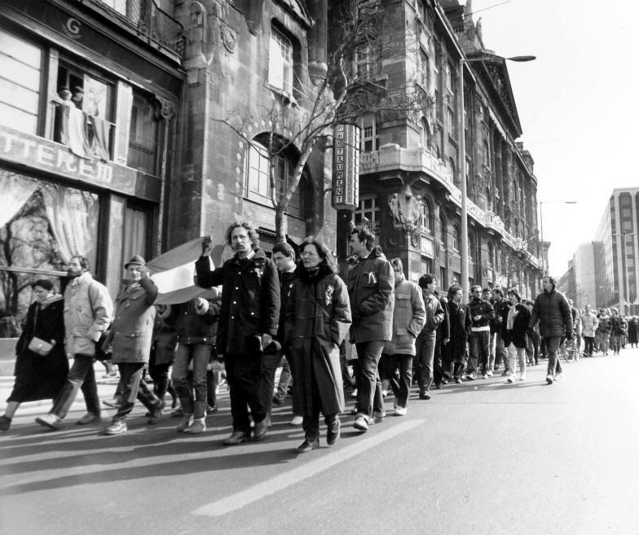
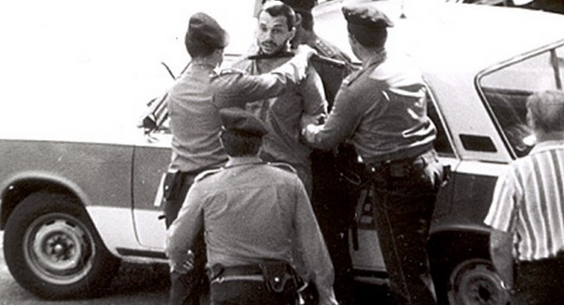
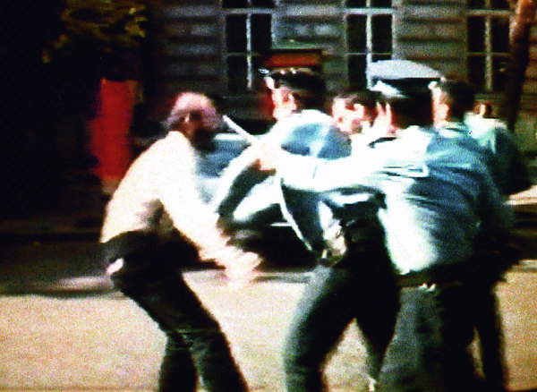
Chronolgy
1980
Bibó memory book (1980)
Monor meeting (1985)
15 March, 1986 – „Chainbridge battle”
1987
1988

Slide 9
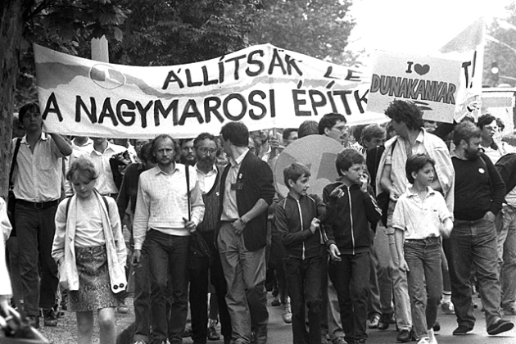
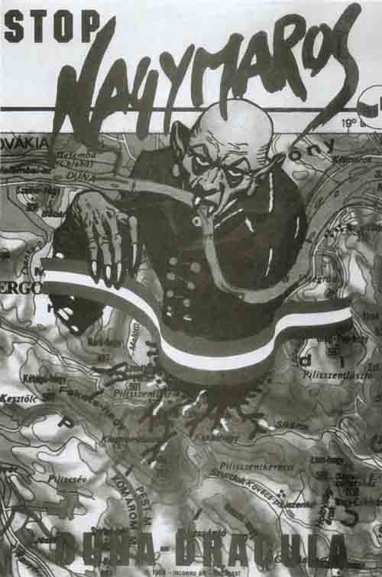
Movements
Danube Circle
(1984)
But:
small churches,
Dialóg peace
movement,
SZETA (Fund for Support the Poor)

Slide 10
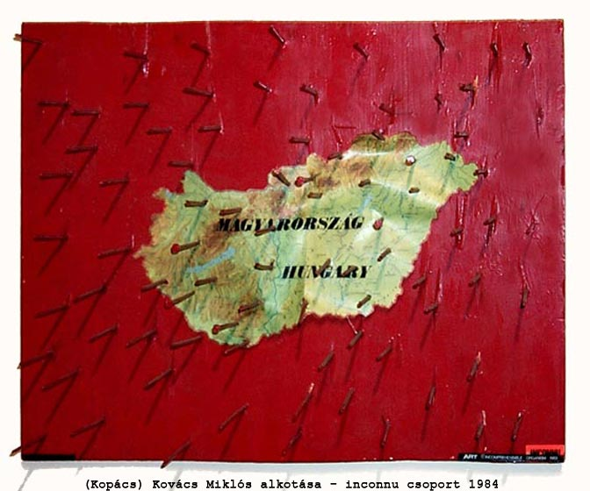
Arts
Inconnu
Group
Artpool
But:
Literature,
Films,
Music

Slide 11
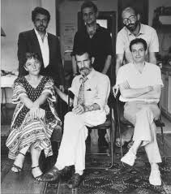
Democratic Encounter group
Beszélő
(Speaker)
1956 revolution

Slide 12
Conclusions
There were no NGOs
Limited publicity of civil society movements, encounter groups and events
Civil society: can be used – and after 1989?
1956 was a strict point
Heritage: emerging self-organising, wish for democracy, freedom, participation in public issues
From 1989: boom of NGOs (20.000)

Slide 13
Thank you for your attention!
giczeyp@unideb.hu

