Slide 1


Youth policy between 1956 and 2016
„Mission impossible – Courage as Virtue in the Politics”
7th November 2016, Hungarian Cultural Institute in Sofia
Dániel, Oross – Andrea, Szabó

Slide 2
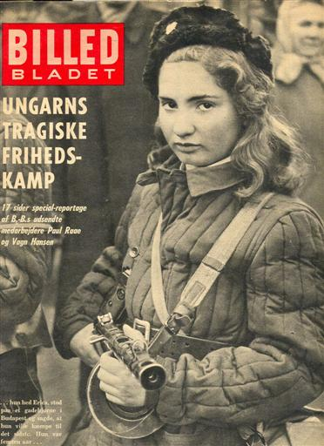


Table of Contents
Youth and the Hungarian revolution of 1956
Consequences of the revolution on Youth
KISZ, the unified youth organization
1971, Youth Act
Established institutions (1971-1989)
The regime change
Youth policy between 1989-2004
Youth policy after the EU accession
Conclusions: transition from youth camps to youth festivals

Slide 3
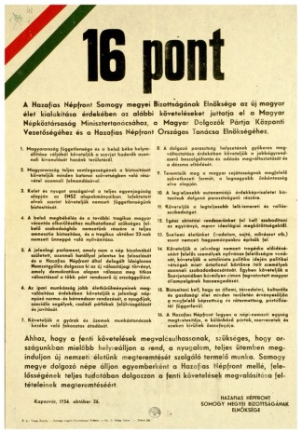
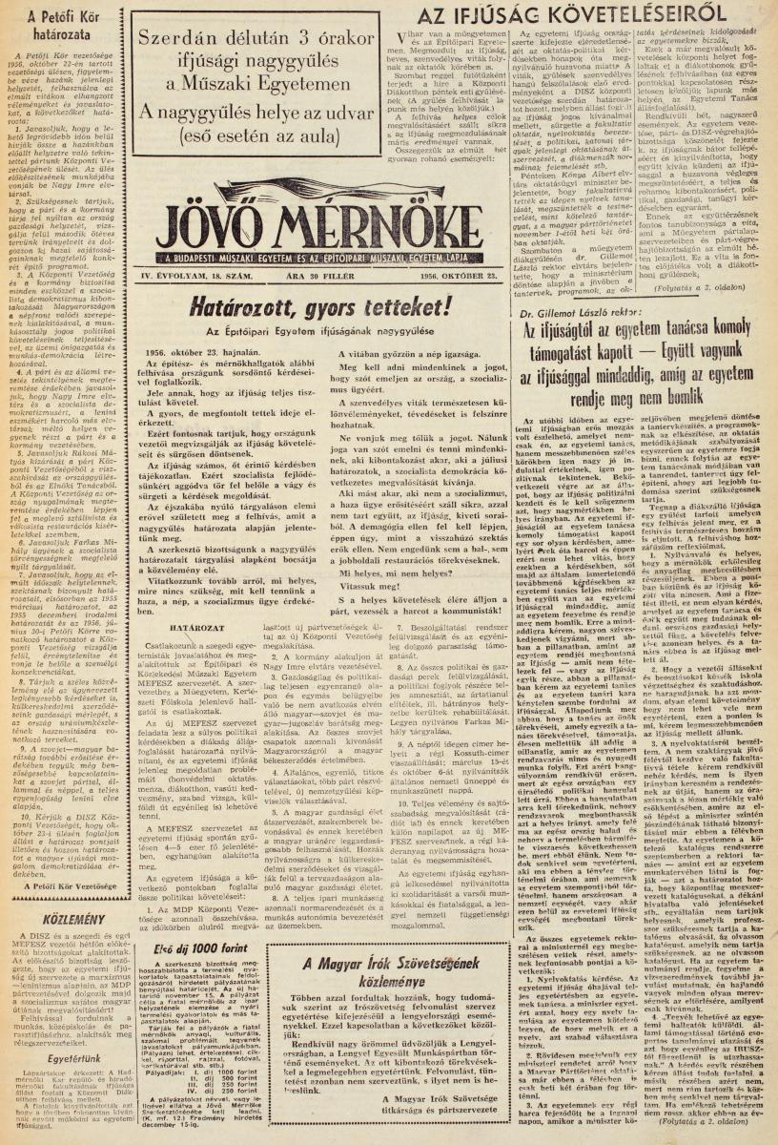
Youth and the Hungarian revolution of 1956
On October 22, 1956, a group of students compiled a list of 16 points containing key national policy demands at the Budapest University of Technology and Economics.
Evacuation of all Soviet troops
Election by secret ballot of all Party members of the Hungarian Workers Party.
A new Government must be constituted under the direction of Imre Nagy:
Public enquiry into the criminal activities of Mihály Farkas and his accomplices. Mátyás Rákosi must be returned to Hungary for trial before a people’s tribunal.
General elections by universal, secret ballot are held throughout the country to elect a new National Assembly,.
Revision and re-adjustment of Hungarian-Soviet and Hungarian-Yugoslav relations in the fields of politics, economics and cultural affairs.
Complete reorganisation of Hungary’s economic life under the direction of specialists.
Our foreign trade agreements and the exact total of reparations that can never be paid must be made public.
Complete revision of the norms operating in industry ; radical adjustment of salaries.
The system of distribution has to be organised on a new basis.
Reviews by independent tribunals of all political and economic trials as well as the release and rehabilitation of the innocent.
Complete recognition of freedom of opinion and of expression, of freedom of the press and of radio.
We demand that the statue of Stalin, symbol of Stalinist tyranny and political oppression, be removed
We demand the replacement of emblems foreign to the Hungarian people by the old Hungarian arms of Kossuth.
The students of the Technological University of Budapest declare unanimously their solidarity with the workers and students of Warsaw and Poland.
The students of the Technological University of Budapest will organise local branches of MEFESZ, and they have decided to convene a Youth Parliament at which all the nation’s youth shall be represented by their delegates.

Slide 4
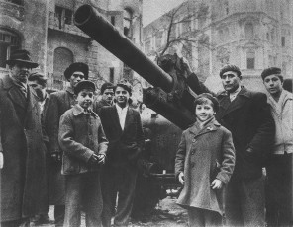
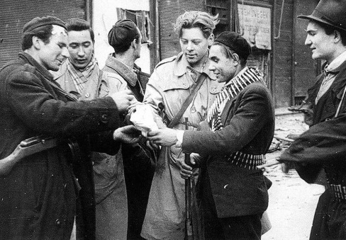
Youth and the Hungarian revolution of 1956
Following an anti-Soviet protest march through Budapest, the students attempted to enter the city's main broadcasting station to read their demands on the air. The students were detained, and when people gathered outside the broadcasting station to call for their release, the state security police fired on the unarmed crowd, setting off the Hungarian Revolution of 1956.
Hungarian Youth was the most active part of the society during the revolution (just as in 1848).

Slide 5
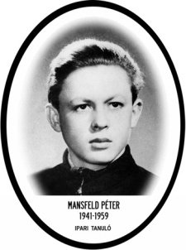
Consequences of the revolution on Youth
Emigration: 200.000 people left Hungary (about 2% of the population)
Retaliation: about 400 people were executed (Act 4 of 1957 made death penalty possible for juveniles over 16 years).
About 21 600 were imprisoned and 13000 interned.
Taking control over youth: bringing youth under public ownership of the party-state (from the age of 6 until 20).

Slide 6


Socialist Youth Movement(1957-1989)
Pioneer – Member of Communist Youth Union – future Communist
The Communist Youth League (KISZ) was an organisation without real participation opportunities, acting more as transmitter of Communist Party policy over youth rather than as defender of youth interests against the omnipotent party-state.

Slide 7
Youth Act (1971)
“Let’s give them a bit of Jimi Hendrix, but no Cohn Bendit!”
In 1971 Hungary passed one of the first youth laws in Europe, but it still remained a tool for controlling young people, and yet certain freedoms were accorded in small niches of leisure time (Wootsch, 2010:107).

Slide 8
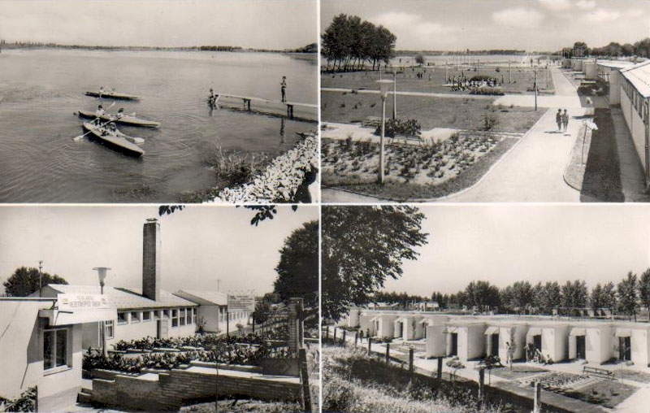
(1971-1989)
New institutions were established during that period, for example, youth research became legal again, the KISZ established a new youth leaders training scheme and the term “youth policy” found its way into political speeches. The aim was to build up the type of new „socialist” man.
Hungarian Institute for Culture
Youth centers, school camps, work camps
Centralized initiatives, centrally controlled processes, and aggregated resource allocation.

Slide 9
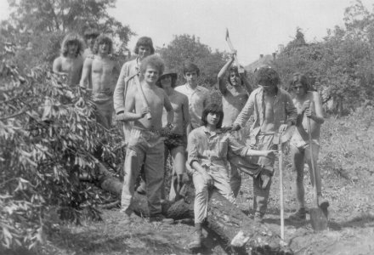
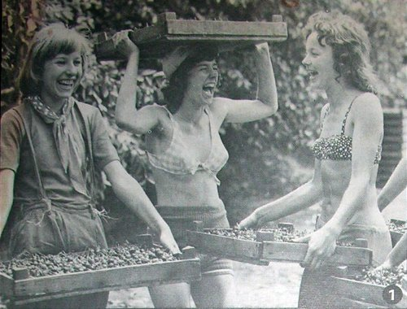
Work camp (Építőtábor)
The Communist Youth Union organized work camps in the whole country. Students were recruited to work (mostly in the agriculture) during their holiday - (Gergely, F. 2008:123)

Slide 10
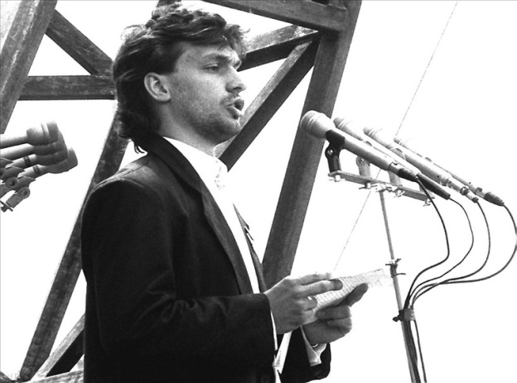
1989
Young people became free from paternalistic state control, but at the same time the state support they enjoyed in the past has also disappeared (Kovaceva, 2000:74).
During the regime change, FIDESZ was founded as an alternative to KISZ. When Imre Nagy's body was reburied with full honours Viktor Orbán spoke as a representative of the Hungarian Youth.

Slide 11
A long transition (1989-2004)
Between 1992 and 2012 Hungarian youth organisations had no national umbrella organisation, access to international cooperation was not granted, and therefore the number and stability of international contacts was low.
Youth organisations met with several difficulties. They had to face undeveloped legislation and weak legal stability, lack of comprehensive state policy toward the NGO’s, and insufficiency of traditions and experience, technology and information base.

Slide 12
Institutionalization of Youth policy
1995: Mobilitás (the Hungarian national agency for youth affairs)
1999 a Ministry of Youth and Sports was founded
Since 2000, a research on large sample has been carried out every 4 years
Since 2003 there is a youth worker training

Slide 13
EU accession
New sources of information
Networking opportunities
New programs and financial resources
White Paper on Youth (2001)
National Youth Strategy (2009-2024)
National Youth Council of Hungary- umbrella organisation since 2012

Slide 14
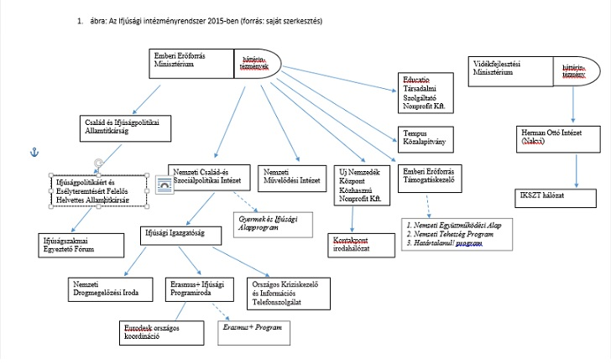
Hungarian youth policy today: Fragmentation and Europeanization
Youth policy is characterized by fragmentation. Policy tools, youth services and institutions do not support the socialization and involvement of young people into society at local, regional, national and European level (Wootsch 2009).

Slide 15
Hungarian youth today
Most young Hungarians prefer individualised lifestyles and escape into privacy.
Companies and private enterprises are not motivated by tax legislation for corporate social responsibility, and very few youth NGOs have such opportunities.
In international comparisons, Hungarian young people appear particularly uninterested in politics (Oross-Szabó, 2013).

Slide 16
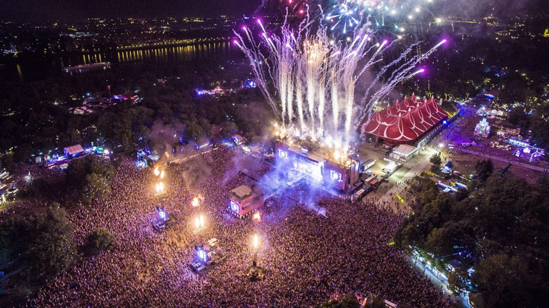
Conclusions
Youth has played an important role in revolutionary changes throughout Hungarian history (1848, 1956). But beyond revolutionary changes their political representation was weak.
Because of their revolutionary spirit those people in power after 1956 have considered young people as a suspicious group of the Hungarian society. The state party has taken control over youth.
After 1989 young peoples’ organisations no had no national umbrella organisation for a long time. Their political representation is weak and political parties are uninterested in youth affairs. Young Hungarians prefer individualised lifestyles and escape into privacy.
This is how the „Youth of Work Camps” became the „Youth of the Festival Camps”.

Slide 17
Thank you for your attention!
Dániel Oross
oross.daniel@tk.mta.hu
Andrea Szabó
szabo.andrea@tk.mta.hu
MTA TK PTI
http://politologia.tk.mta.hu/

Slide 18
Selected literature
Gergely F. (2008): KISZ A Magyar Kommunista Ifjúsági Szövetség története 1957-1989. Holnap Kiadó Budapest.
Kovacheva, S. K. (ed.) (2000): Keys to youth participation in Eastern Europe, Strasbourg, Council of Europe Publishing.
Oross D., Szabó A. (2013): Students' relationship to democracy. In: Szabó Andrea (szerk.) Political Orientations, Values and Activities of Hungarian University and College Students..Prague: Heinrich Böll Stiftung, pp.9-20.
Youth Policy in Hungary, Conclusions of the Council of Europe international review team, Council of Europe Publishing, Strasbourg, 2008. october.
Wootsch, P. (2010): Zigzagging in a labyrinth – Towards “good” Hungarian youth work. In: The history of youth work in Europe, Volume 2. (eds. Filip Coussée, Griet Verschelden, Tineke Van de Walle, Marta Mędlińska, Howard Williamson, Council of Europe Publishing, Strasbourg, p. 105-111.

