Slide 1
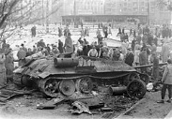
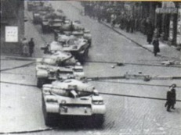
The Memory of 56 Traces of past and Cultural Heritage in Europe of an interrupted dream of democratising socialism
7 th November 2016

Slide 3
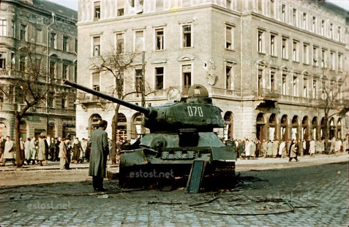
…counterrevolutionary bands…

Slide 4
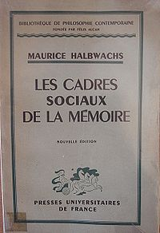
Maurice Halbwachs (1877 – 1945)

Slide 5
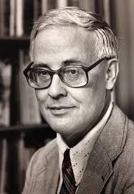
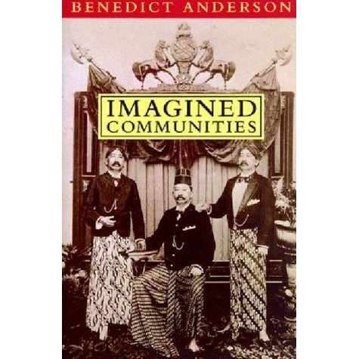
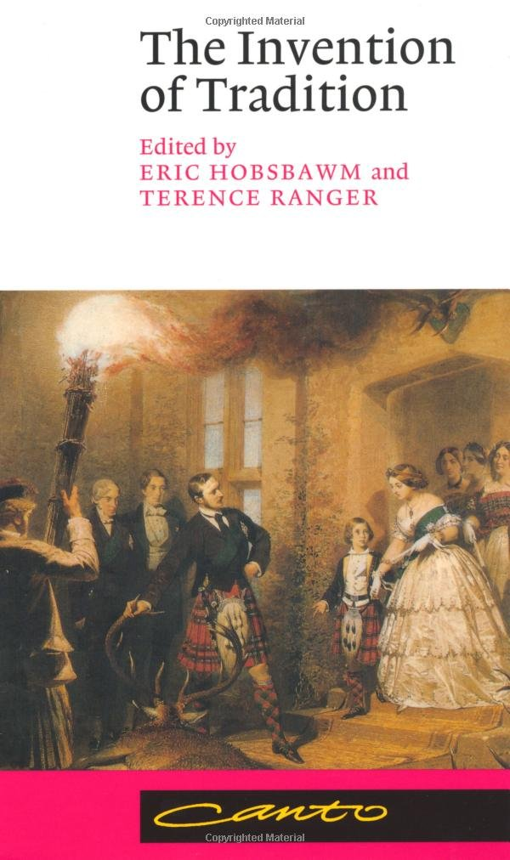
Eric J. Hobsbawm (1917 – 2012)
Benedict Anderson (1936 – 2015)

Slide 6
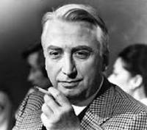
Roland Barthes (1915 – 1980)
Victor Turner (1920 – 1983)
Capitalization: an experience
of recognition of the past through
its signs, with a process of
authentication.
Threshold: the limit between
a community which has been destroyed
and a community which is being rebuilt.
Here the symbolic role of the past takes place,
becoming «cultural asset».

Slide 7
Polish Law 15 february 1962
It protects «cultural monuments»
An absolutely prevalent role is given to the State
It defines the concept of «social property»

Slide 8
Lenin’s Mausoluem – March 1925

Slide 9
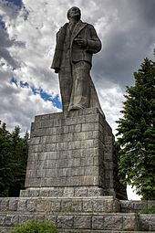
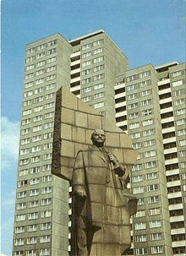
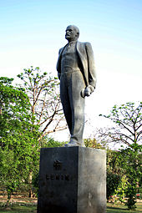
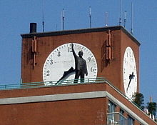
Lenin’s Square - Krasnoyarsk
Lenin’s Square - Dubna
LeninPlatz – East Berlin
East Village – New York City
Lenin at Nehru Park - India

Slide 10
Penza Planetarium - 1954
Stalinallee - Berlin

Slide 12
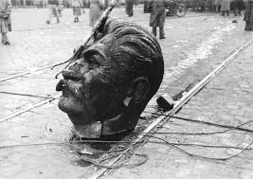

Slide 14
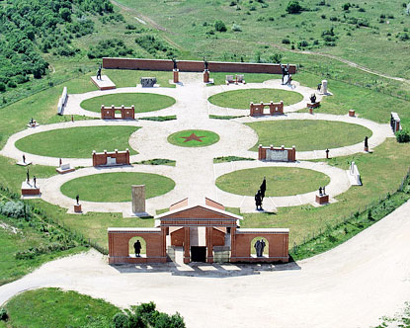
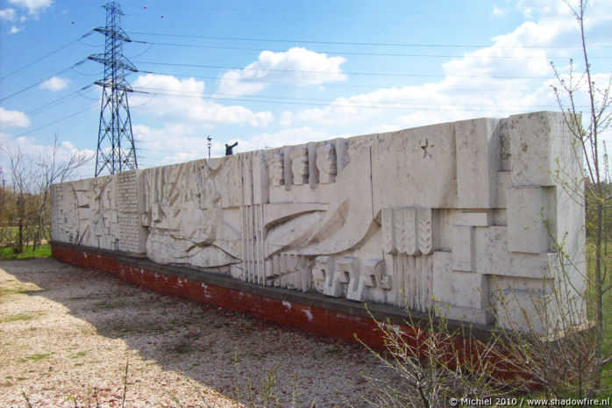

Slide 15
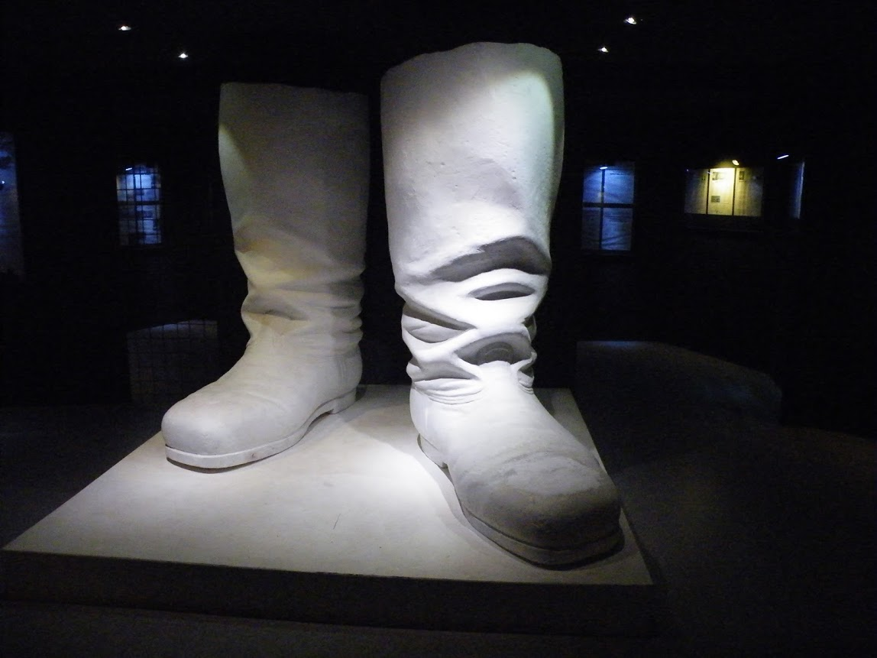

Slide 16
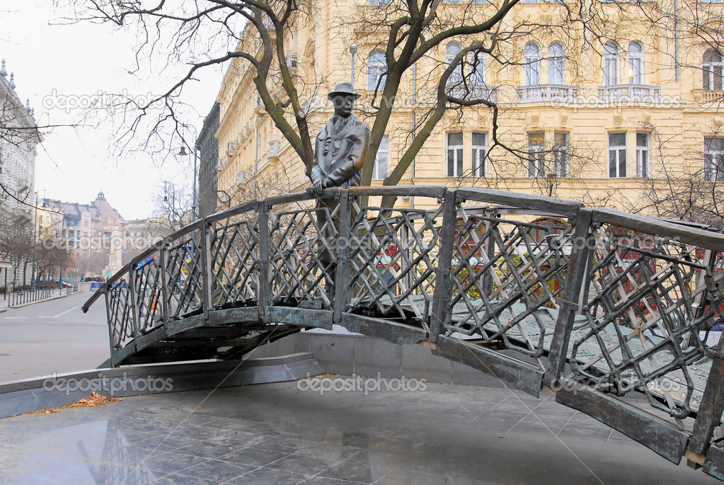

Slide 18
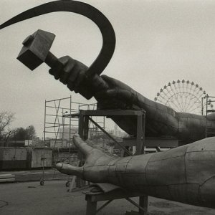

Slide 20
